Slide 1
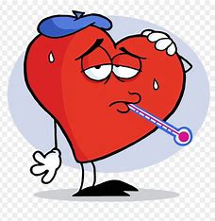
Cardiovascular Health Assessment and Risk Prediction
Project By : Arti Yadav
www.linkedin.com/in/arti-yadav-428b11229

Slide 2

INTRODUCTION
The human heart beats about 2.5 billion times over an average lifetime, pushing millions of gallons of blood throughout the body. This steady blood flow carries oxygen, hormones, and other compounds. It also whisks away the waste products of metabolism.
Heart disease and cardiovascular disease are two of the most significant heart health issues. They are often used interchangeably, but they are not the same.
Heart disease refers to diseases of the heart, such as coronary artery disease, heart failure, heart valve abnormalities, and abnormal heart rhythms.

Slide 3
Problem statement
The goal of this machine learning project is to develop a predictive model to identify if they are at risk of heart diseases. Heart diseases have unfortunately become very common. It may be due to various reasons such as lifestyle, work pressure, lack of exercise, etc. In this project, we will be working on predicting the 10-year risk of Coronary Heart Disease (CHD). We are given a set of variables that impact heart diseases. These variables are related to demographic, past, and current medical history.

Slide 4
Purpose
In this project we are going to develop a model that could predict which person are more likely to have a risk of coronary heart disease in next 10 years. We are going to explore the data and then create a model to predict how likely the person get a heart disease.

Slide 5
Project structure
Data Understanding
Data Preprocessing
Exploratory Data Analysis (EDA) - Pandas/Numpy
Model Selection and Training
Model Evaluation using ML Algorithms for CHD Prediction
Classification Report and Accuracy Explaination

Slide 6
Data Dictionary
Demographic:
• Sex: male or female ("M" or "F")
• Age: Age of the patient;(Continuous - Although the recorded ages have been truncated to whole numbers, the concept of age is continuous)
Education :
1 - Higher Secorndary, 2- Graduate, 3 - Post Graduate 4- Doctarte or PHD
Behavioural:
• is_smoking: whether or not the patient is a current smoker ("YES" or "NO")
• Cigs Per Day: the number of cigarettes that the person smoked on average in one day .(can be considered continuous as one can have any number of cigarettes, even half a cigarette.)
Medical (history):
• BP Meds: whether or not the patient was on blood pressure medication (Nominal)
• Prevalent Stroke: whether or not the patient had previously had a stroke (Nominal)
• Prevalent Hyp: whether or not the patient was hypertensive (Nominal)
• Diabetes: whether or not the patient had diabetes (Nominal)
Medical(current):
• Tot Chol: total cholesterol level (Continuous)
• Sys BP: systolic blood pressure (Continuous) • Dia BP: diastolic blood pressure (Continuous)
• BMI: Body Mass Index (Continuous)
• Heart Rate: heart rate(Continuous - In medical research, variables such as heart rate thought discrete, are considered continuous because of a large number of possible values.)
• Glucose: glucose level (Continuous)
Predict variable (desired target):
• 10-year risk of coronary heart disease CHD (binary: “1”, means “Yes”, “0” means “No”) – DV

Slide 7
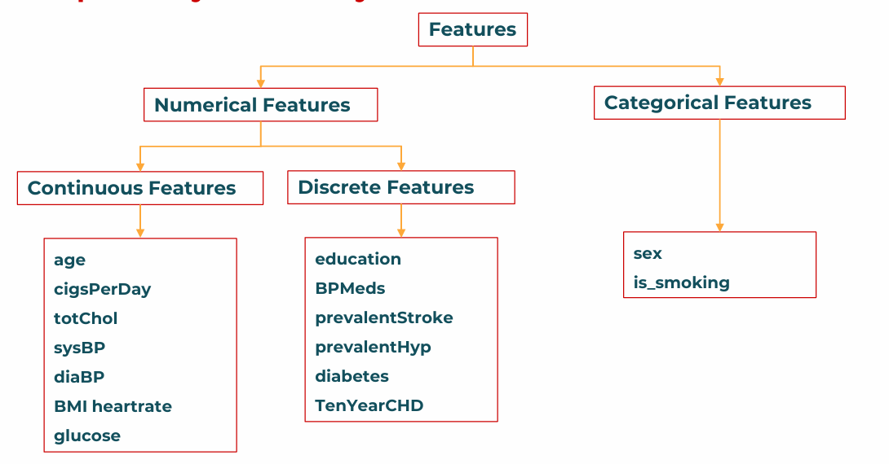
Feature Discription

Slide 8
Summary of the project
The dataset contains 3390 observations with 17 features.
The target variable is "TenYearCHD", which is a binary variable indicating whether patient will get coronary heart disease in next ten year or not.
The goal of the project is to develop a model to predict patients who might get CHD and identify key factors contributing to Heart Disease
The project will involve exploratory data analysis, feature selection, and building and evaluating machine learning models.
Potential benefits of the project include improved peoples health condition.

Slide 9
Exploratory data analysis
Exploratory Data Analysis (EDA) is a fundamental step in data science projects. It involves studying and exploring datasets to understand their key characteristics, discover patterns, identify outliers, and reveal relationships between variables. Here are the primary goals of EDA:
Data Cleaning:
We have around 10% missing data we’ll impute this data according to their datatypes.
We don’t have any duplicate values in dataset.
The dataset contains outliers ,we will trat by IQR method.
Descriptive Statistics:
EDA uses statistical measures (e.g., mean, median, standard deviation, range) to understand variable tendencies, variability, and distributions.
Data Visualization:
Visual techniques (histograms, countplot , pie plots, etc.) represent data graphically.
These visualizations help identify trends, patterns, and relationships.

Slide 10
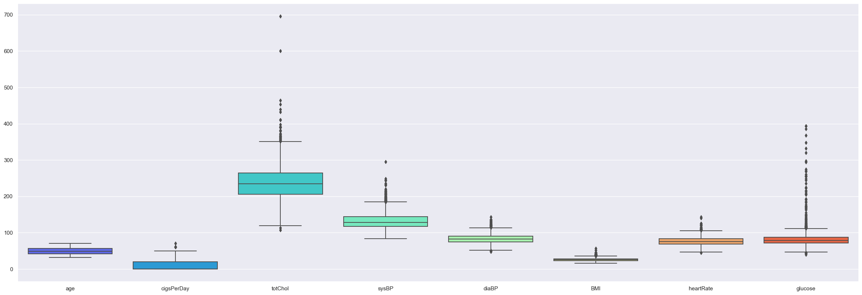
Outliers in Datasets
From above boxplot we can find out:
We can see the five point summary of the each attributes i.e. minimum, first quartile [Q1], median, third quartile [Q3] and maximum.
We can see, there are outliers present 'totChol', 'sysBP', 'diaBP', 'BMI','hearRate','glucose' columns.
In 'cigPerDay' ,'totChol' and 'glucose',we can see that ouliers are sensitive.
The glucose & cholestrol have the highest no. of outliers.
we will fill the null values with median in these columns & outliers with IQR method.
The remaining columns outliers will not affect our analysis as it is very less.
In diaBP , sysBP and heartRate the ranges are above normal, It can be the reason for increase in risk of CHD.
We can keep this outliers as it is important in our analysis and prediction.

Slide 11
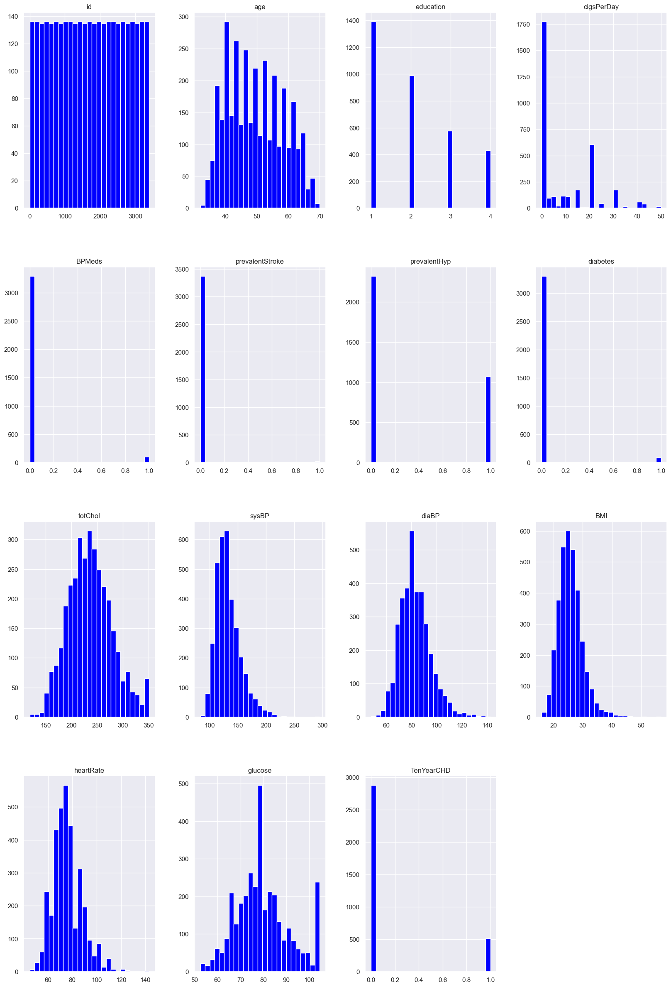
Exploration of variables using Histogram
A few observations can be made based on this plots for features:
Many histograms are tail-heavy; indeed several distributions are right-skewed (e.g. hearRate, glucose,sysBp,diaBP, BMI).
Age distribution is a slightly right-skewed normal distribution with the bulk of the patients between 40 and 60 years old.
Also we can observe that most of the patients are non-smokers, but those who are smoking are highly addicted as cigrate per day counts are above 20.

Slide 12
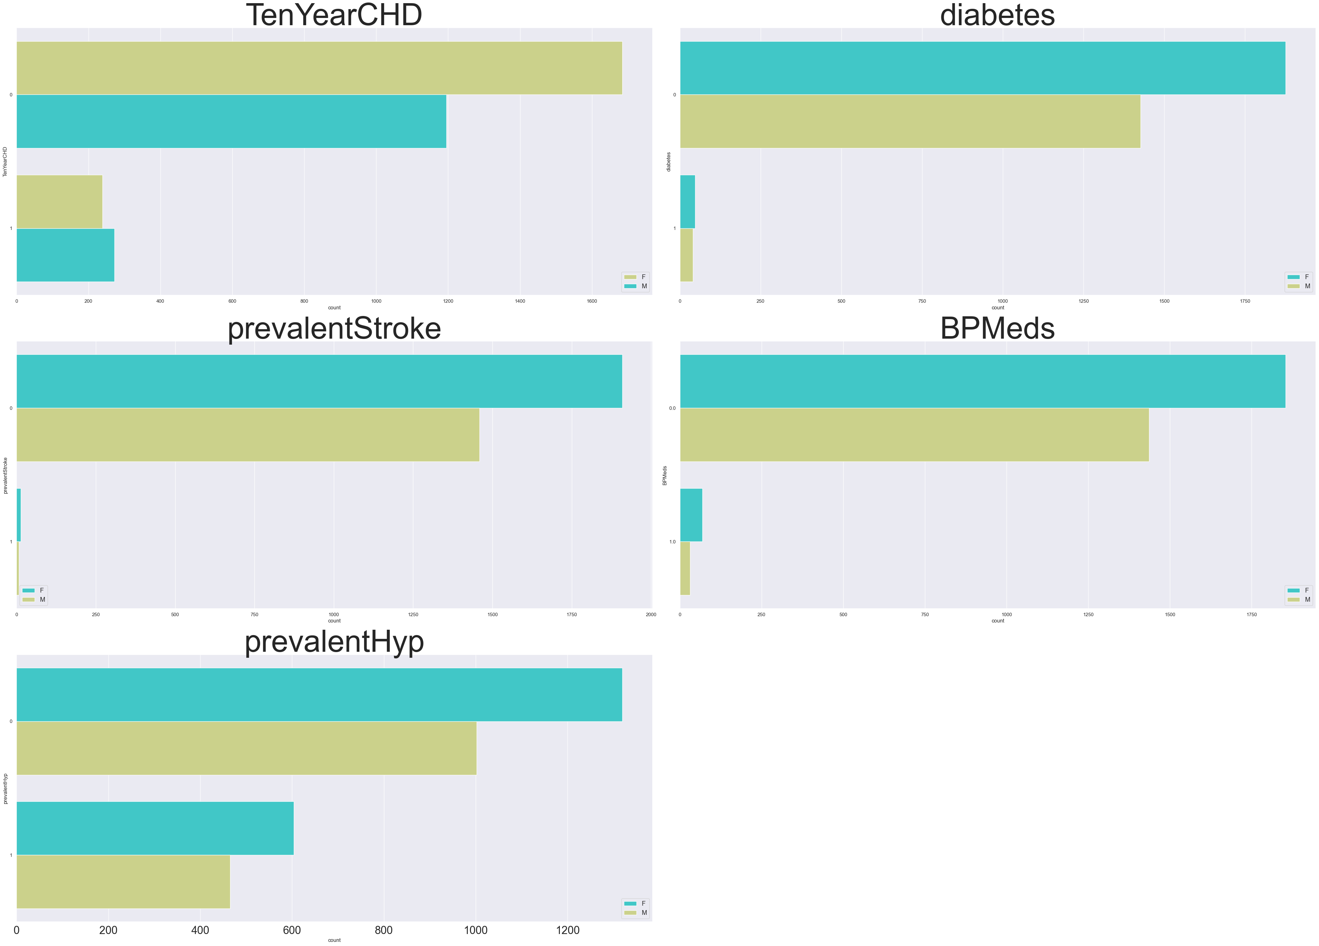
Exploration of categorical variables by gender
From this countplot we can observe:
We can see Gender-wise countplot data for all the categorical columns.
We can get Idea various categorical sub-values and their frequency with reference to Gender of patients.
Risk rate is greater in Male than Female patients.

Slide 13
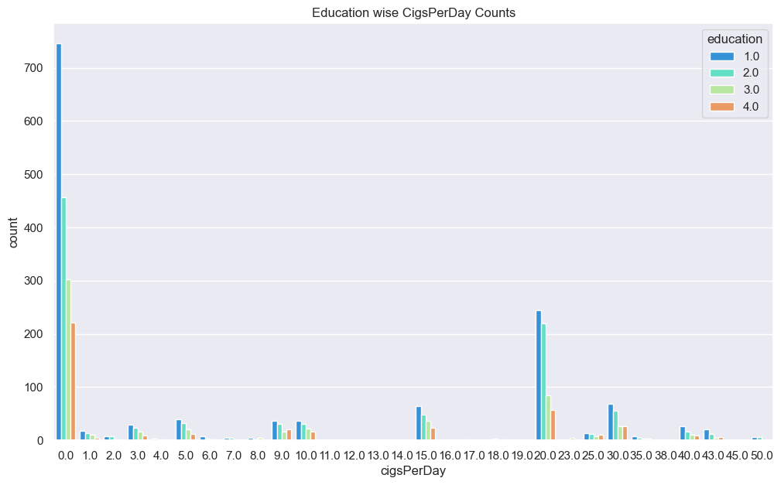
Education wise CigsPerDay Counts
From above plot a few observation can be made:
Most no. of people are in non-smoking category.
Some of the people who are pursuing Higher Secondary are leading the chart, it means they have habit of smoking and their cigsPerDay counts are also high. It may be due to pressure of studies or due to impact of bad influence.
Followed by people pursuing graduation , Post- Graduation and PHD ,It also may be due to pressure of careers or may be personal issues or previous habit of smoking.

Slide 14
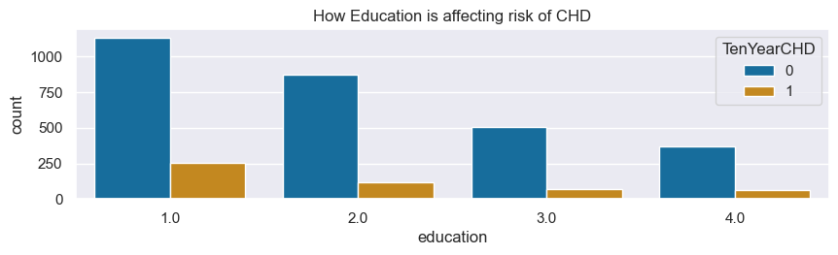
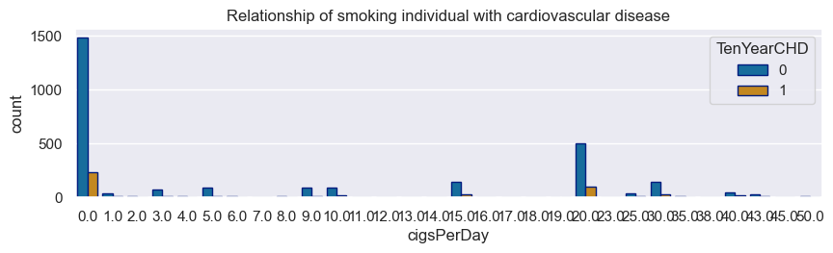
How Education is related to risk of CHD?
From these plots few key learnings:
Education is the key to success but sometime it may can influence bad behaviour.
Here according to data we can observe that ,individuals who are highly educated may still choose to smoke.
It may be due to factors such as peer pressure, stress, or lack of awareness about the health risk associated with smoking.
This behaviour may lead do risk of CHD in future.

Slide 15
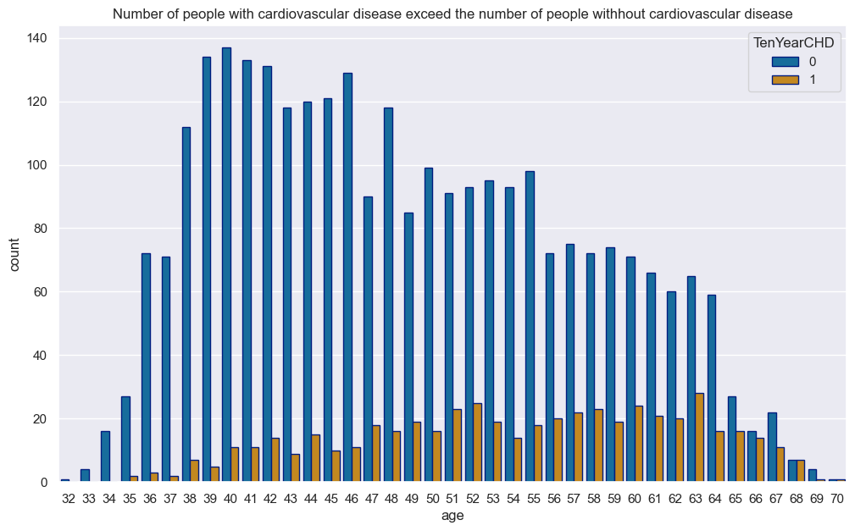
How Age is impacting risk of CHD
As we can see in above plot The people with the highest risk of developing heart disease are between the ages of 51 and 63.
Because human body becomes weaker generally with increasing age.
Age is significant risk factor for Coronary Heart Disease.
The arteries become narrower and less flexible with age, making them more susceptible to plaque buildup , which can lead to CHD.

Slide 16
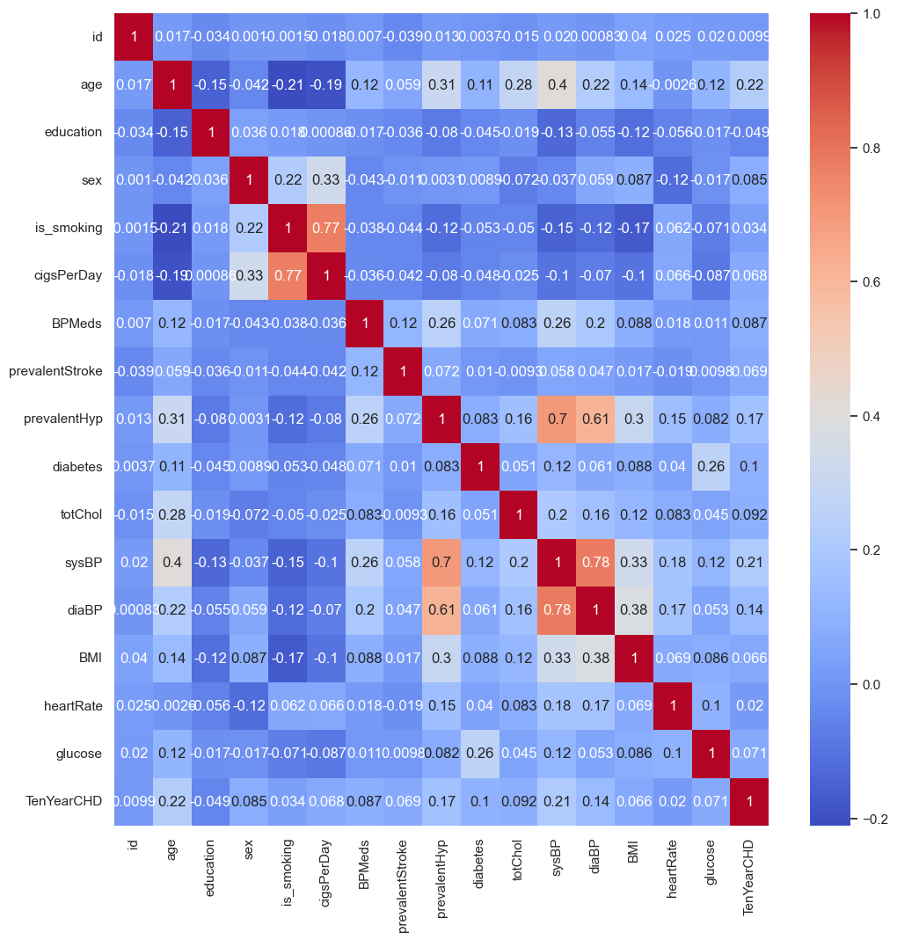
Feature Selection by Correlation
Few key Learnings from the correlation visualisation heatmap above:
'cigsPerDay' has 77%(Strong positive) correlation with 'is_smoking', both the columns are giving same information so we can drop one.
'diaBP' has 78%(Strong positive) correlation with 'sysBP', however both parameters are crucial for assessing cardiovascular risk but 'sysBp' is often considered more critical ,especially in older adults,as it is strong predictor of cardiovascular events like Heart attack & strokes.
So we can drop diaBP to avoid multicolinearity issue.

Slide 17
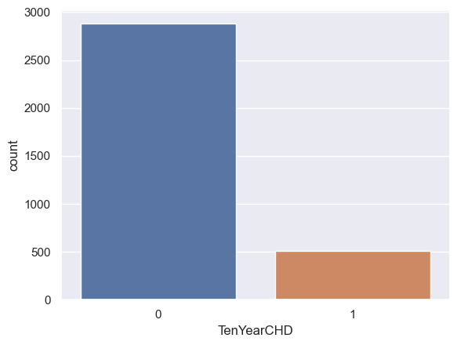
Class Distribution Of target variable
No. of people have more risk of CHD= 511
No. of people have less risk of CHD= 2879
As we can see the classes are highly uneven , data is imbalanced.
An imbalanced dataset often lead to biased prediction.
Therefore, handling imbalanced data is crucial for fair model performance.

Slide 18
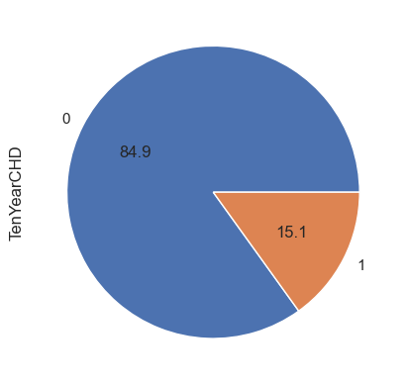
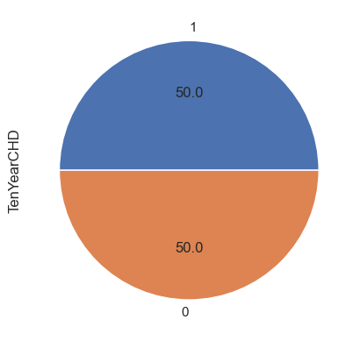
Handling Imbalanced Data
By SMOTE (Synthetic Minority Oversampling Technique)
BEFORE
AFTER
SMOTE addresses this issue by oversampling the minority class.
Instead of simply duplicating existing examples from the minority class (which doesn’t add new information), SMOTE synthesizes new examples.
These synthetic examples lie along the decision boundary, effectively augmenting the minority class.

Slide 19

Model Selection and Training
Machine Learning Models are mathematical representations. In other words ,they are the output we receive after training a process.
What Machine Learning model does is discover the patterns in a training dataset. In other words,machine learning model map inputs to the outputs of the given dataset
Models Used are:
1. Logistic Regression
2. K-Nearest Neighbors
3. Bagging Classifier
4. Random Forest
5. XG Boosting
6. Gradient Boosting

Slide 20

Model Evaluation
Training Accuracy:
Logistic Regression: 66.4%
K-Nearest Neighbors: 89.0%
Bagging Classifier: 100%
Gradient Boosting: 86.60%
Random Forest PP: 88.9%
XG Boosting: 99.6%
Testing Accuracy:
Logistic Regression: 66.7%
K-Nearest Neighbors: 79.1%
Bagging Classifier : 89.5%
Gradient Boosting : 83.4%
Random Forest PP: 81.4%
XG Boosting: 88.6%
We can observe that training accuracy for all models are very good except for logistic regression.
Testing accuracy for all models are above 75% except for logistic regression.
However, on comparison we can say that KNN, Bagging Classifier , XG Boosting are of high variance indicating these models are overfitted.
Random Forest & Gradient Boosting models are giving testing accuracy above 80% without variance, so we can consider this two models.

Slide 21
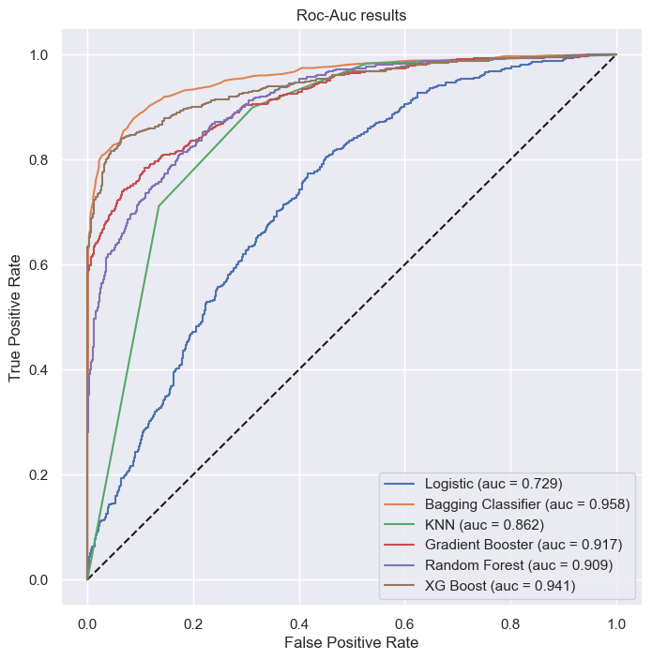
ROC-AUC
The higher the AUC, the better the model’s performance at distinguishing between the positive and negative classes.
A greater value of AUC denotes better model performance.
All the models having AUC above 0.7 ,indicates that all models are performing well.

Slide 22
Conclusion
In this analysis, some important results were found as follows:
The topic uses Machine Learning models to come up with the best model for predicting CHD risks.
most of the models giving high variance indicating a overfitted model.
The best model given is the Logistic Gradient Boosting & Random forest-Post pruning as theses models are not giving high-bias or high variances and also have better F1 Score.
The accuracy of the Random forest model is 81.4%. ROC is very high (auc = 90.9%).
The accuracy of the Gradient oosting model is 83.4%. ROC is very high (auc = 91.7%).
It indicating that both the model have good predictive power.
Note :for more better results we can have more data.

Slide 23
Key findings
Factors such as cigsPerDay, sysBP, diaBP and Age were found to be important predictors of heart disease.
Additionally, lifestyle factors accumulated over time , such as poor diet, lack of exercise , and smoking, can further increase the risk of CHD .
The health care faculty can use the model to identify patients who are at high risk of having heart disease and take proactive measures to reduce them.

Slide 24
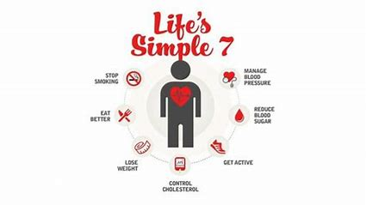
Suggestion
Lowering the risk of heart disease involves adopting a healthy lifestyle and managing risk factors. Here are some key strategies:
Healthy Diet
Regular Exercise
Maintain a Healthy Weight
Quit Smoking
Limit Alcohol
Manage Stress
Monitor Blood Pressure
Control Cholesterol Levels
Manage Diabetes
Get Regular Check-ups
By adopting these lifestyle changes and working with your healthcare provider to manage risk factors, you can significantly lower your risk of heart disease and promote overall heart health.

Slide 25

Thank You……..

